Slide 1
HOTEL RESERVATION ANALYSIS WITH SQL

Slide 2
OBJECTIVE
To analyse hotel booking data to identify patterns and trends, optimize room pricing improve guest experiences and ultimately increase hotel revenue and operational efficiency
DATA
The data is taken from the hotel databases.
The data contains 700 rows and 12 columns.
Data contains 6 numerical columns and 6 non numerical columns.

Slide 3
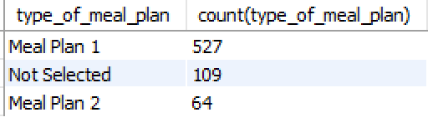
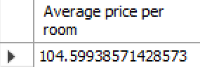
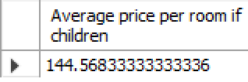
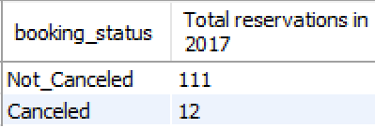
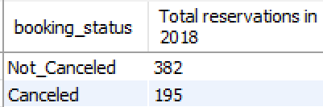
ANALYSIS
Meal plan 1 is the most popular among guests.
Average price per room is $104.6 and the average price increases to $144.56 when there is children.
There is 78.6% increase in reservations and 93.8% increase of cancellations from 2017 to 2018
Most common room type is Room 1 with 534 reservations.

Slide 4
Minimum number of days between booking and arrival is ‘0’ and there is a maximum number of 443 days between booking and arrival.
Online market segment is most common preference by the guests.
There is maximum bookings in the month of October in 2017 and June in 2018.
Room type 4 has maximum average number of nights.
Room type 6 is the costliest room type if there are children.

Slide 5
RECOMMENDATIONS
Most people choosing online for reservations we can improve user interface and make the website more easily usable.
The management need to work on the cancellations and gather some more data about the cancellations as it increased to 94%.
June, April, October months have higher registrations management can give some special offers at this time.
Room type 2, 5, 6, 7 has least reservations need to study why these room types have least reservations.

Slide 6
CONCLUSION
Based on the data the analysis gave some useful insights which can be implemented by the organisation and increase their revenue and also customer satisfaction.
But to get more insights we need some more data related room types, meal plans and about cancellations.

